Slide 1
“A Journey Into Automated Talent Acquisition At Doodle“
11 March 2024
<p> -by Team 14 Rakesh Hadne Sreenath Pavankumar Umesh Managoli Ashwith Anand Poojary </p>
Team 14

Slide 2
Table Of CONTENTS.
01
02
03
04
05
06
11 March 2024
first. Introduction
second. Data Collection
this. Data Cleaning
this. Selection
also. Database
next. Email Notification
Team 14
Slide 2

Slide 3
Table Of CONTENTS.
07
08
09
10
11
12
11 March 2024
next. Webpage Interface
also. Interview Round
this. Server Deployment
this. HR Interface
also. Future Scope
last. Challenges
Team 14
Slide 3

Slide 4
Introduction
11 March 2024
01
Doodle, a famous software company, wants to build an in-house solution to analyze potential talent, examine and evaluate them, and provide them with an interface and select them via email.
Team 14
Slide 4

Slide 5
Problem Statement
11 March 2024
Doodle aims to automate and privatize its recruitment by creating "hushHush Recruiter", a Python-based system that discreetly evaluates candidates using online data points (e.g., GitHub) providing ideal candidates. Further, offers a timed coding challenge platform, providing results which is then looked upon by the HR for selection.
Team 14
Slide 5

Slide 6
What kind of talent?
11 March 2024
Sources
We have collected data from GitHub through the method of API fetching.
Therefore, the hushHush Recruiter system is designed to filter the candidates with link for timed examination.
The results are evaluated, and the selected candidates are then notified via mail.
Team 14
Slide 6

Slide 7
Task Division
11 March 2024
Rakesh Hadne Sreenath
Pavankumar Umesh Managoli
Ashwith Anand Poojary
Data Fetching
Cleaning
Selection Algorithm
Database
Front End
Question Forms
Email Forwarding
Back End
HR Interface
Team 14
Slide 7

Slide 8
Architecture
11 March 2024
Team 14
Slide 8

Slide 9
Data Collection
11 March 2024
02
Team 14
Slide 9

Slide 10
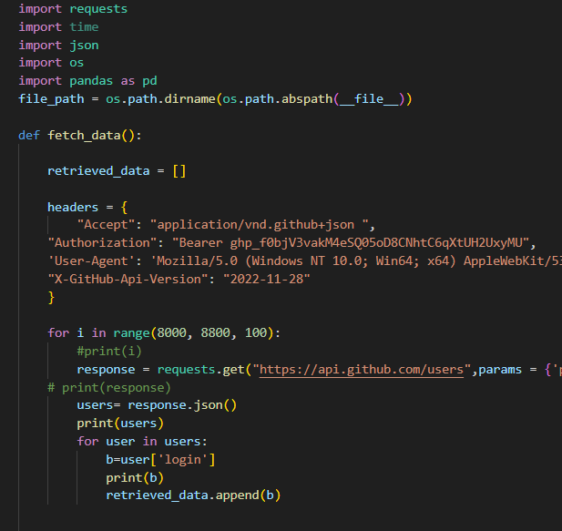
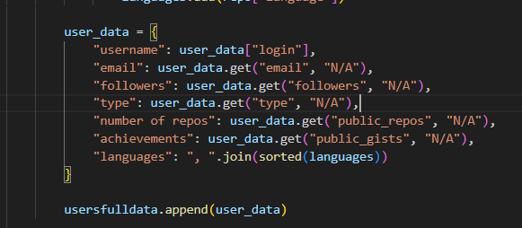
Data Collection
11 March 2024
Data is fetched through GitHub API.
Team 14
Slide 10

Slide 11
Data Cleaning
11 March 2024
03
Team 14
Slide 11

Slide 12
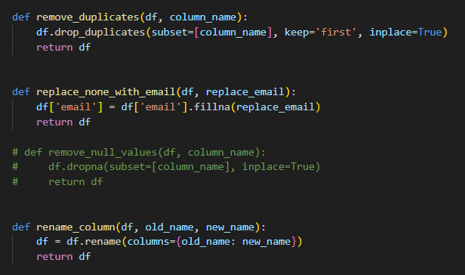
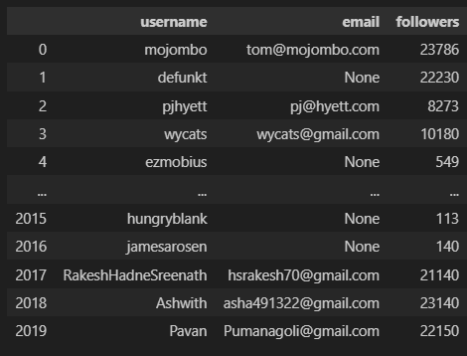
Algorithm
11 March 2024
Data Cleaning of Email Column and Renaming.
Team 14
Slide 12

Slide 13
Selection
11 March 2024
04
Team 14
Slide 13

Slide 14
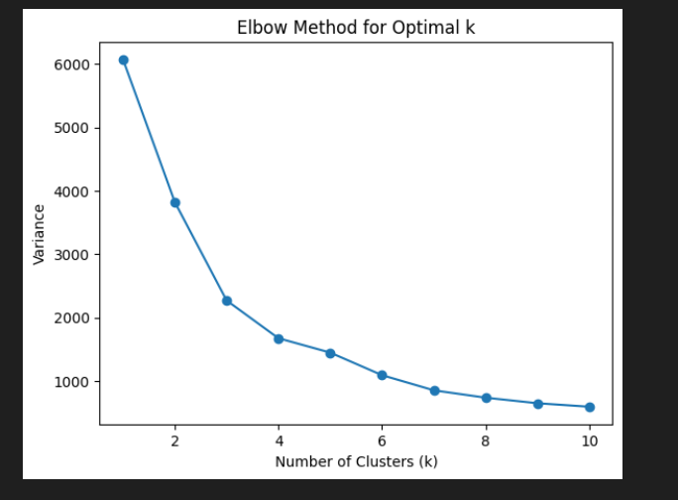
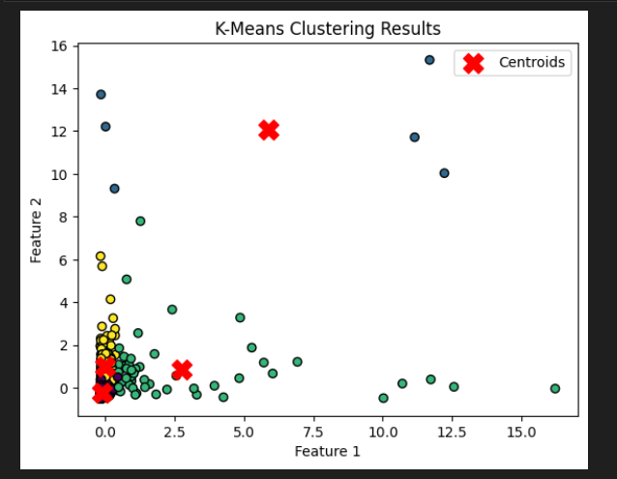
Dataset Clustering
11 March 2024
Using Elbow method, we found that the best number of cluster is 4.
Team 14
Slide 14

Slide 15
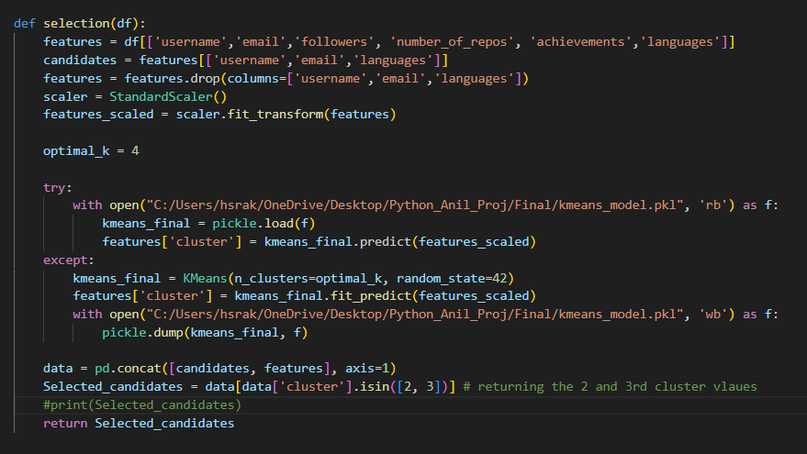
Dataset Clustering
11 March 2024
Using Pickle file to reuse the model when new dataset is being added.
Team 14
Slide 15

Slide 16
Database
11 March 2024
05
Team 14
Slide 16

Slide 17
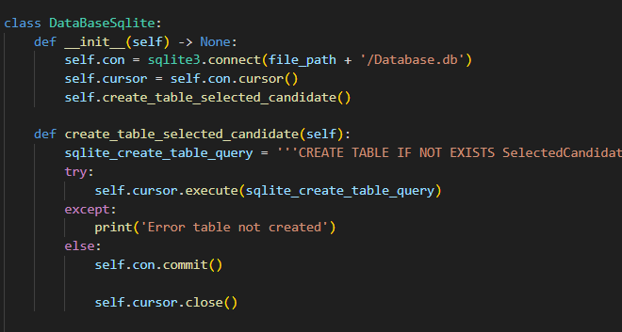
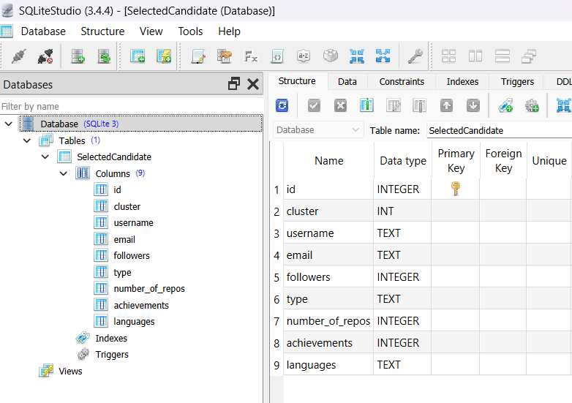
Database
11 March 2024
We are using SQLite as a database.
Team 14
Slide 17

Slide 18
Email Notification
11 March 2024
06
Team 14
Slide 18

Slide 19
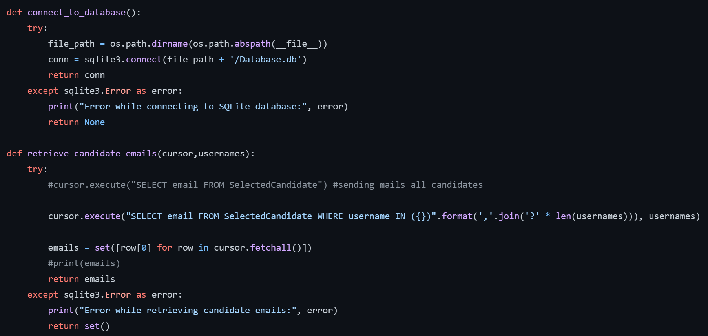
Notifying Candidate
11 March 2024
Connect to SQLite database
Retrieve candidate emails
Team 14
Slide 19

Slide 20
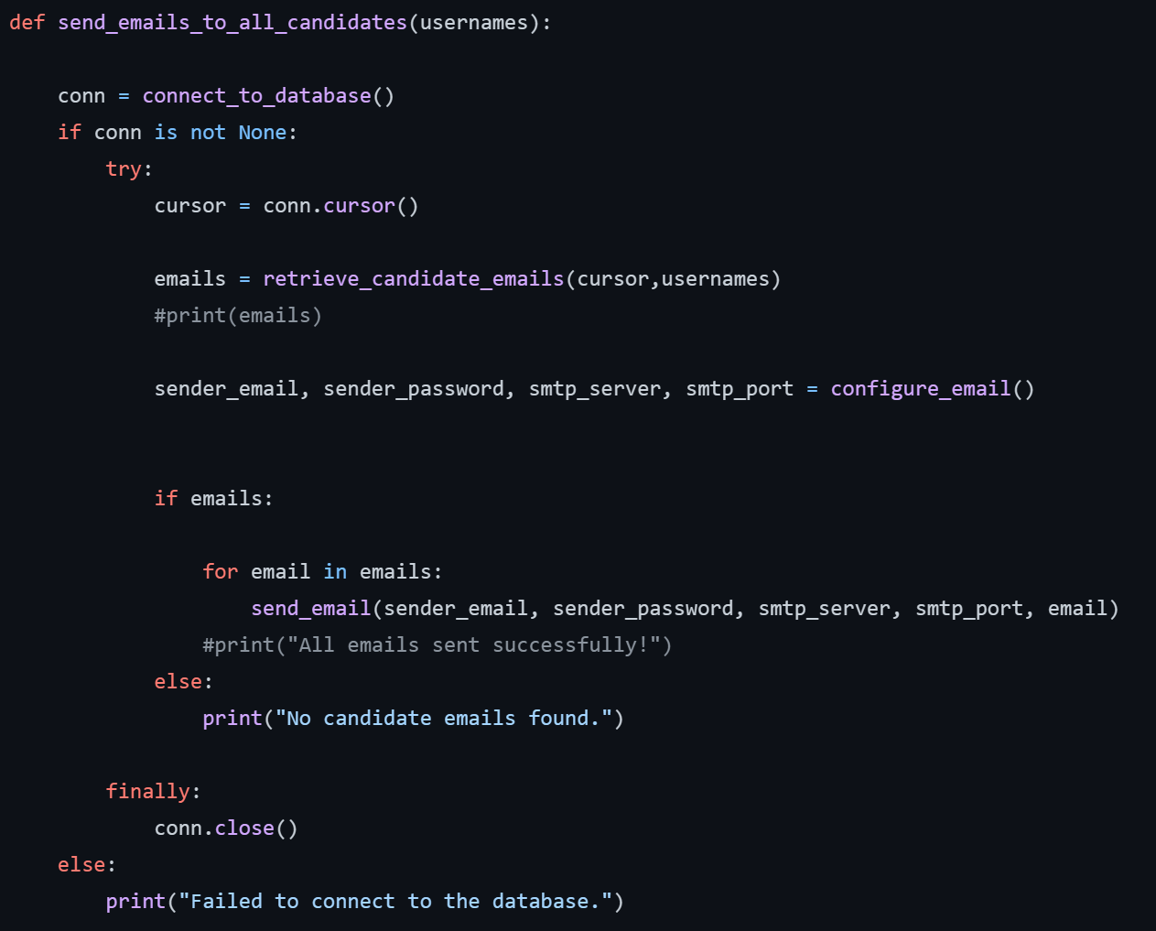
Notifying Candidate
11 March 2024
Sends Emails to Candidates
Team 14
Slide 20

Slide 21
Webpage Interface
11 March 2024
07
Team 14
Slide 21

Slide 22
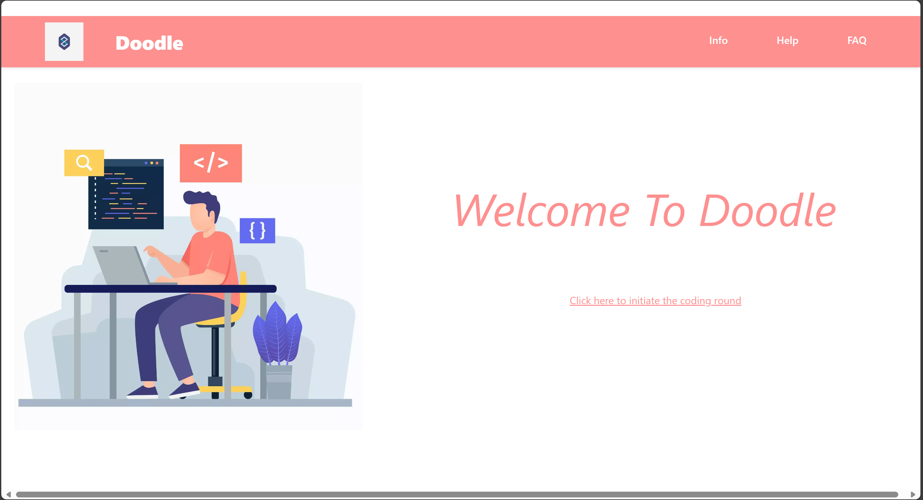
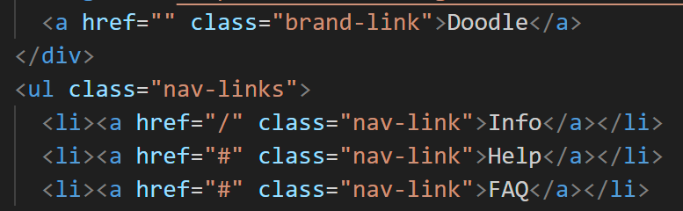
Webpage HTML/CSS/React
11 March 2024
User-friendly experience
Easy to update existing pages
Team 14
Slide 22

Slide 23
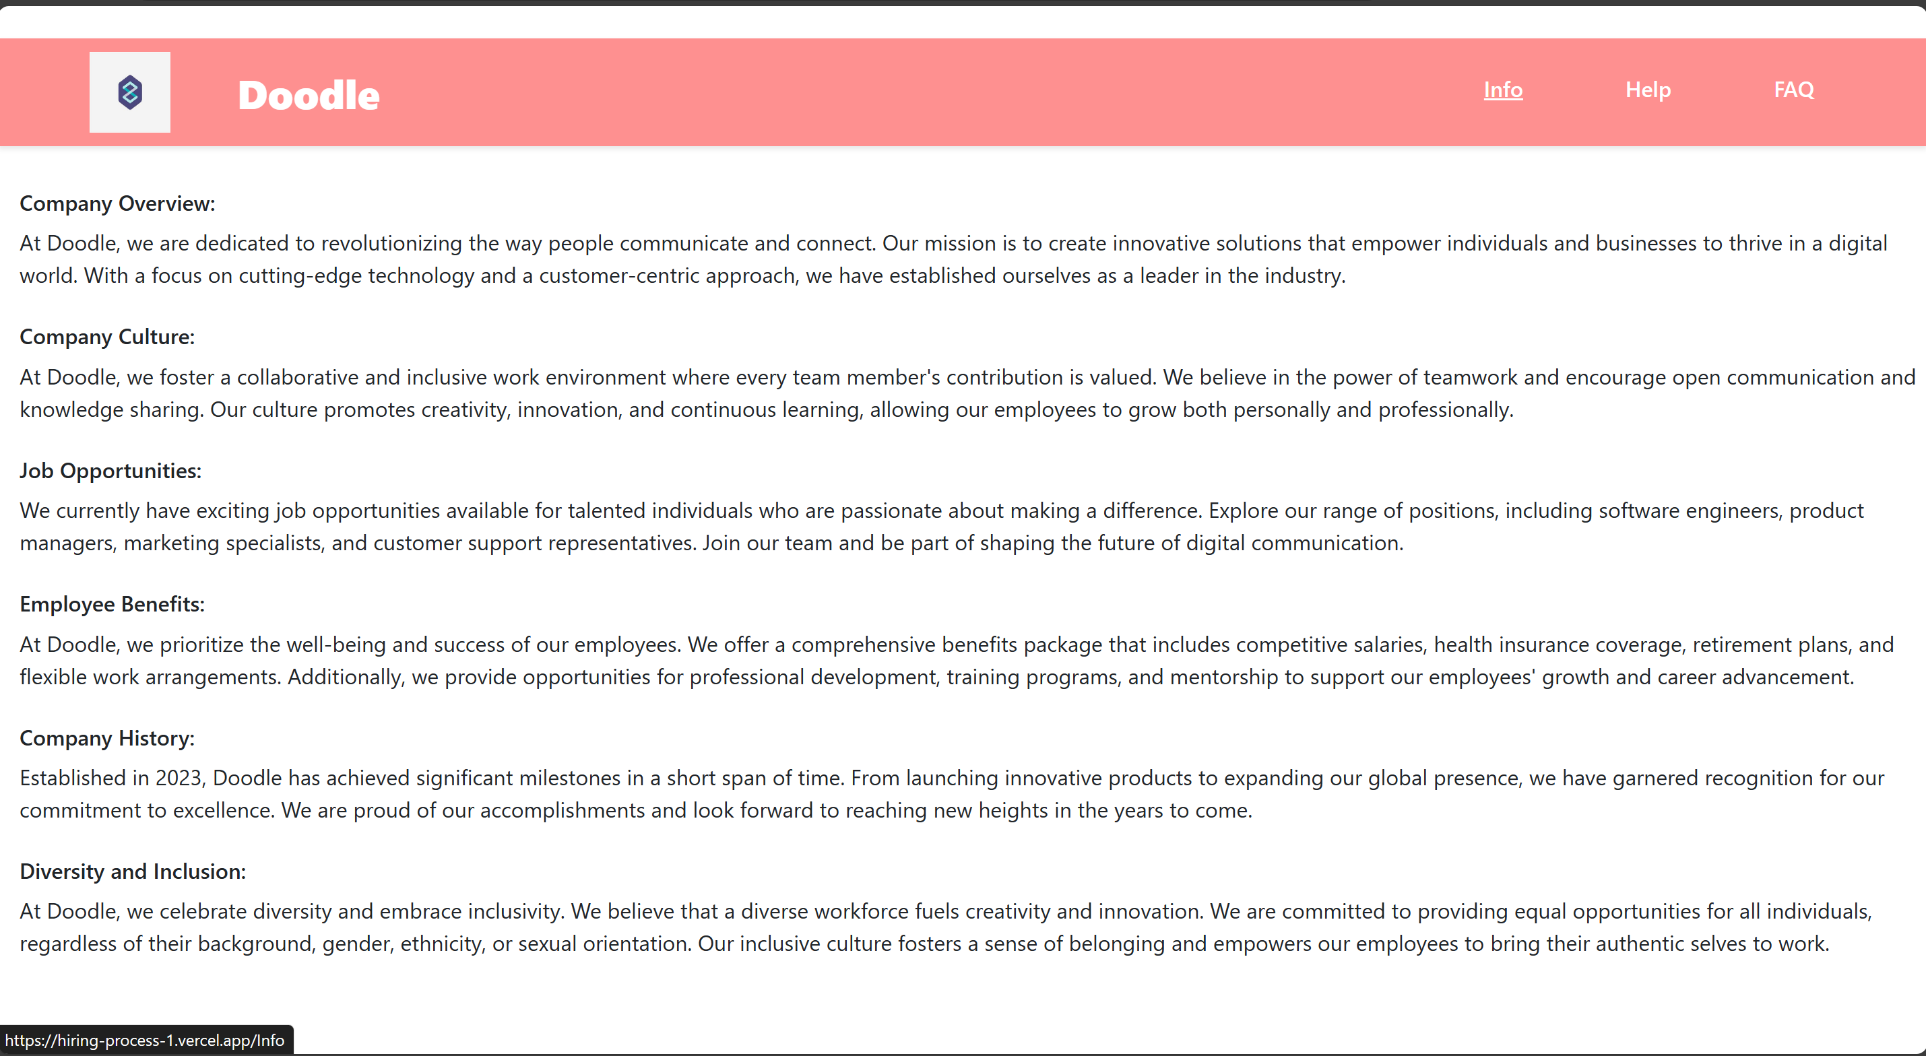
Webpage HTML/CSS/React
11 March 2024
Providing information about the company.
Team 14
Slide 23

Slide 24
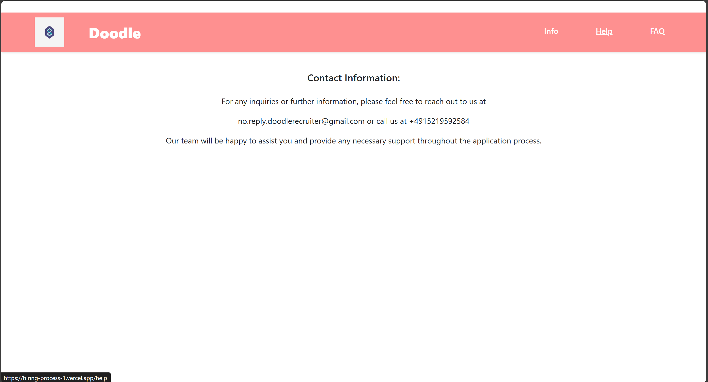
Webpage HTML/CSS/React
11 March 2024
Providing help in case of any issues.
Team 14
Slide 24

Slide 25
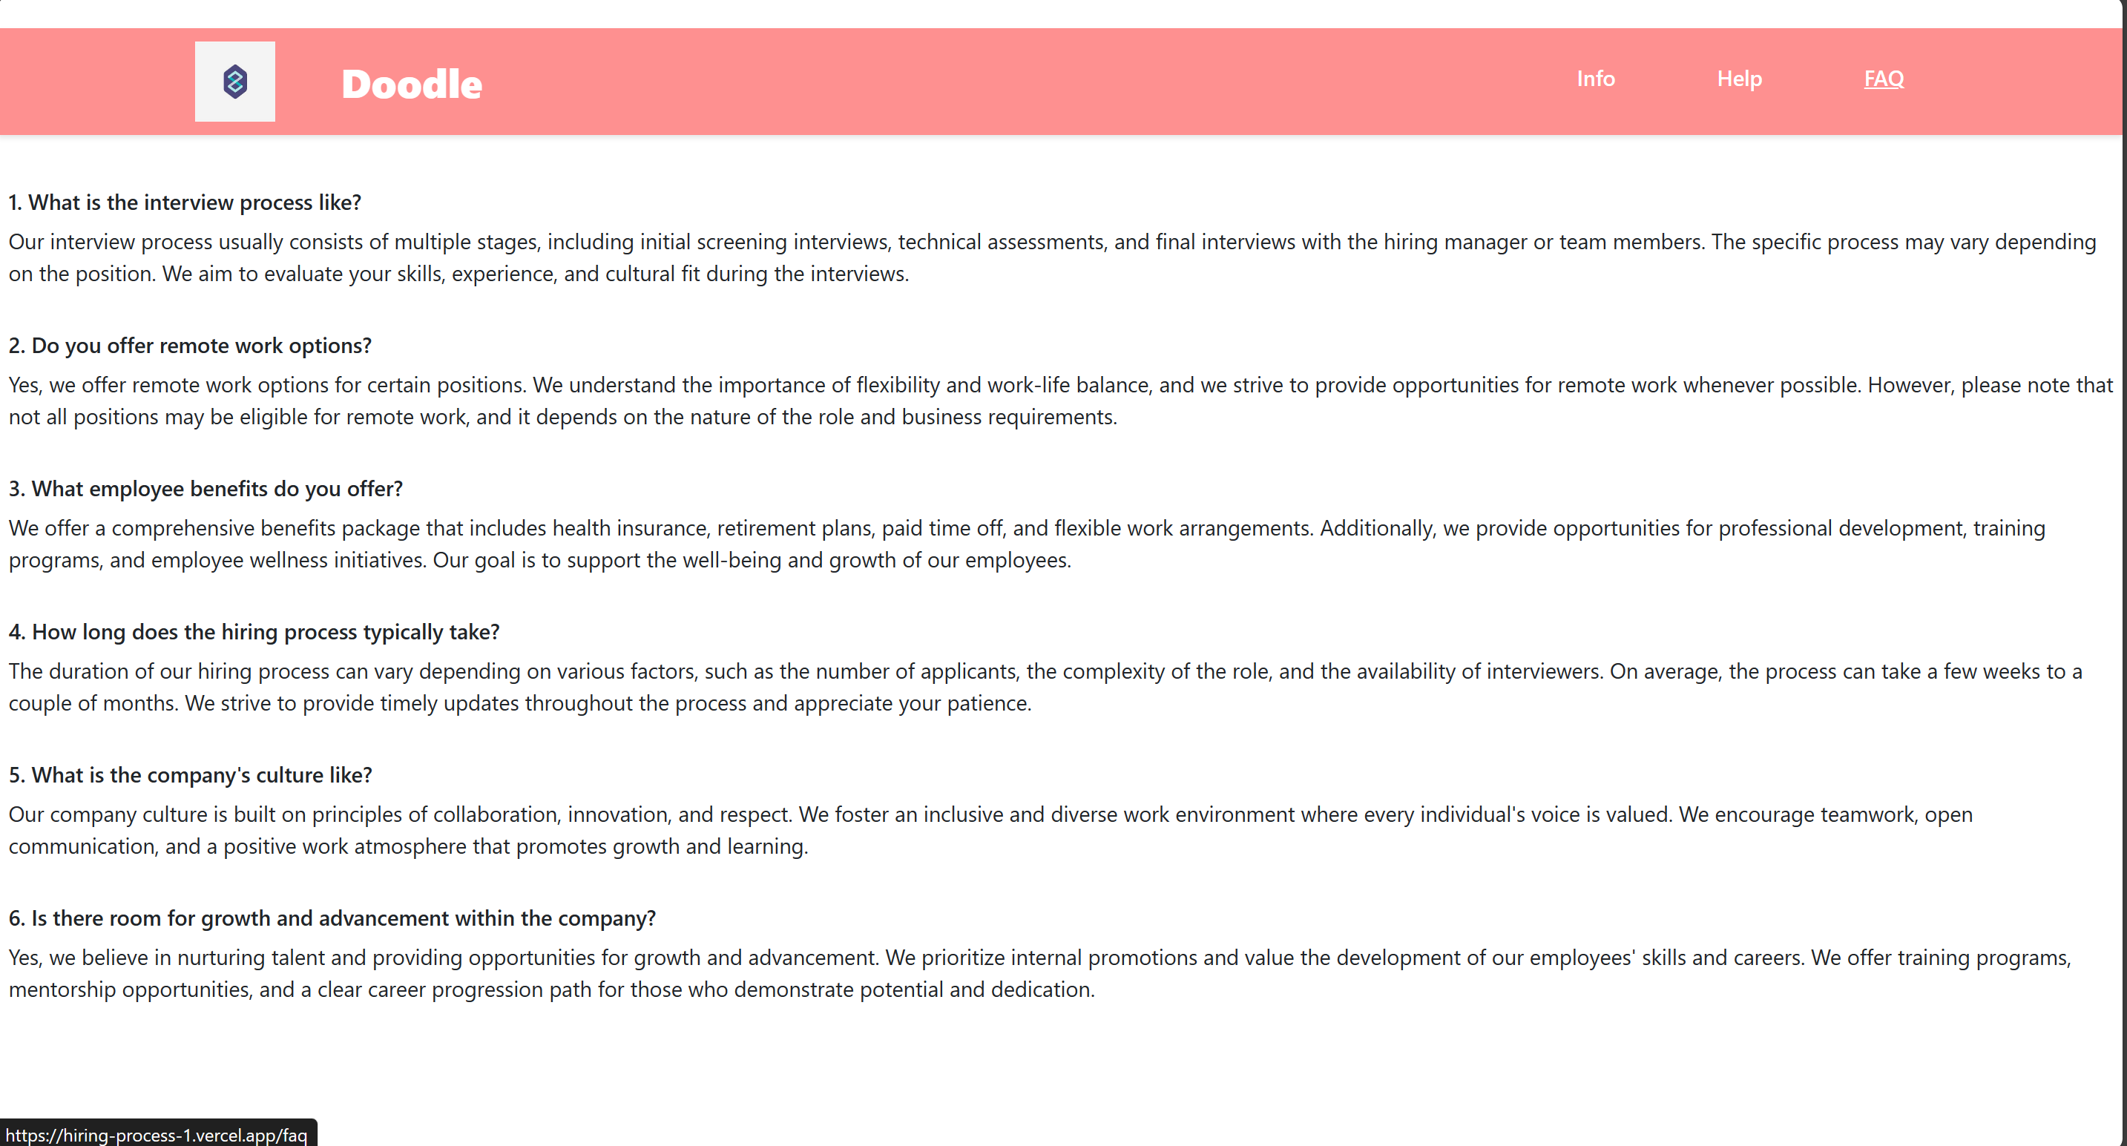
Webpage HTML/CSS/React
11 March 2024
FAQ is preset so that the user has access to common problems-solution.
Team 14
Slide 25

Slide 26
Interview Round
11 March 2024
08
Team 14
Slide 26

Slide 27
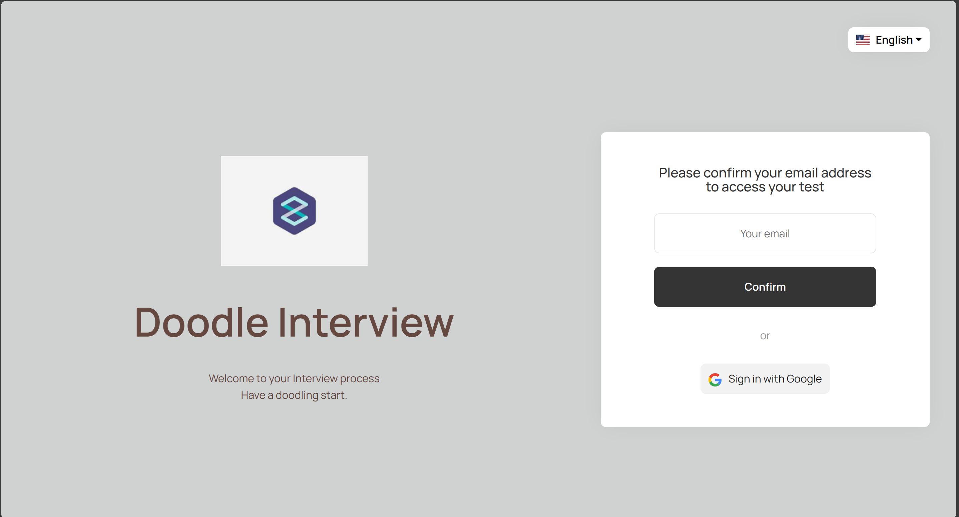
Interview Round
11 March 2024
Login page for entering Interview round
Team 14
Slide 27

Slide 28
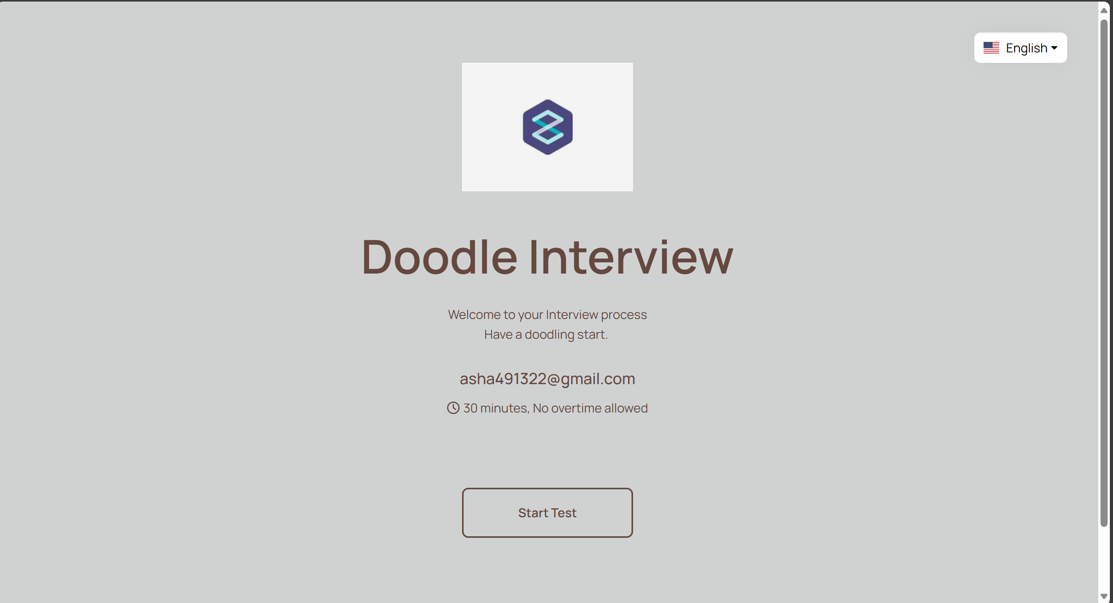
Interview Round
11 March 2024
Initial page
Team 14
Slide 28

Slide 29
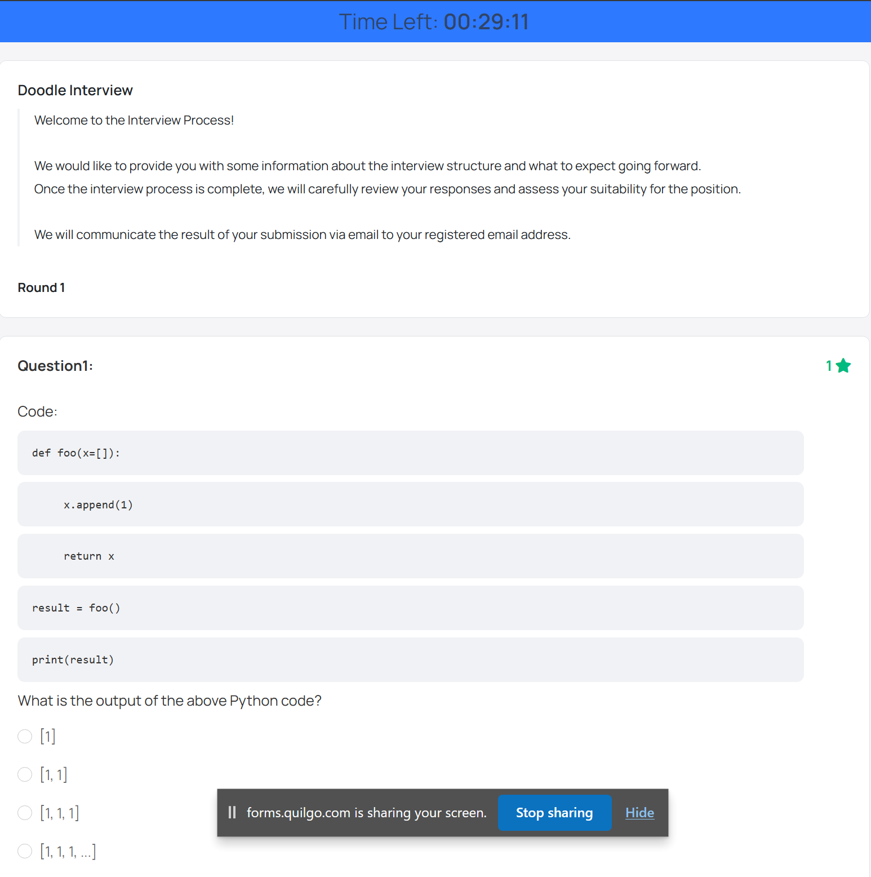
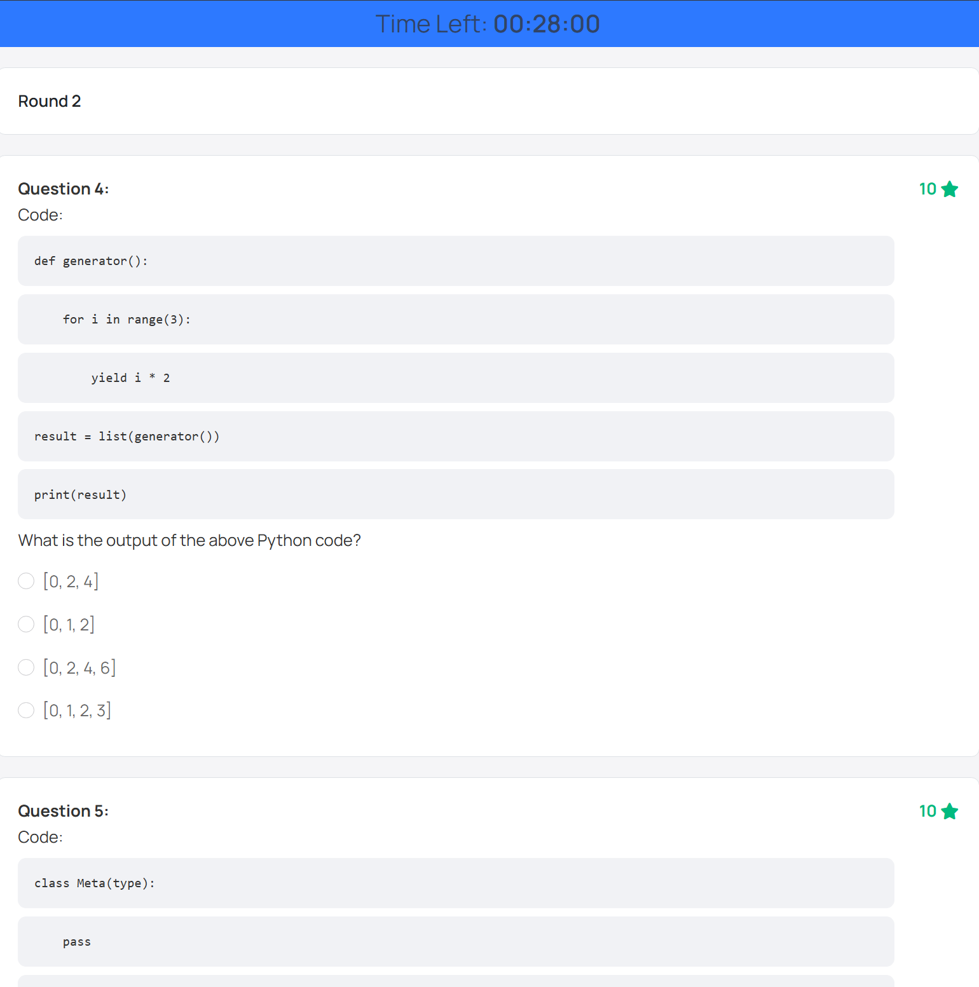
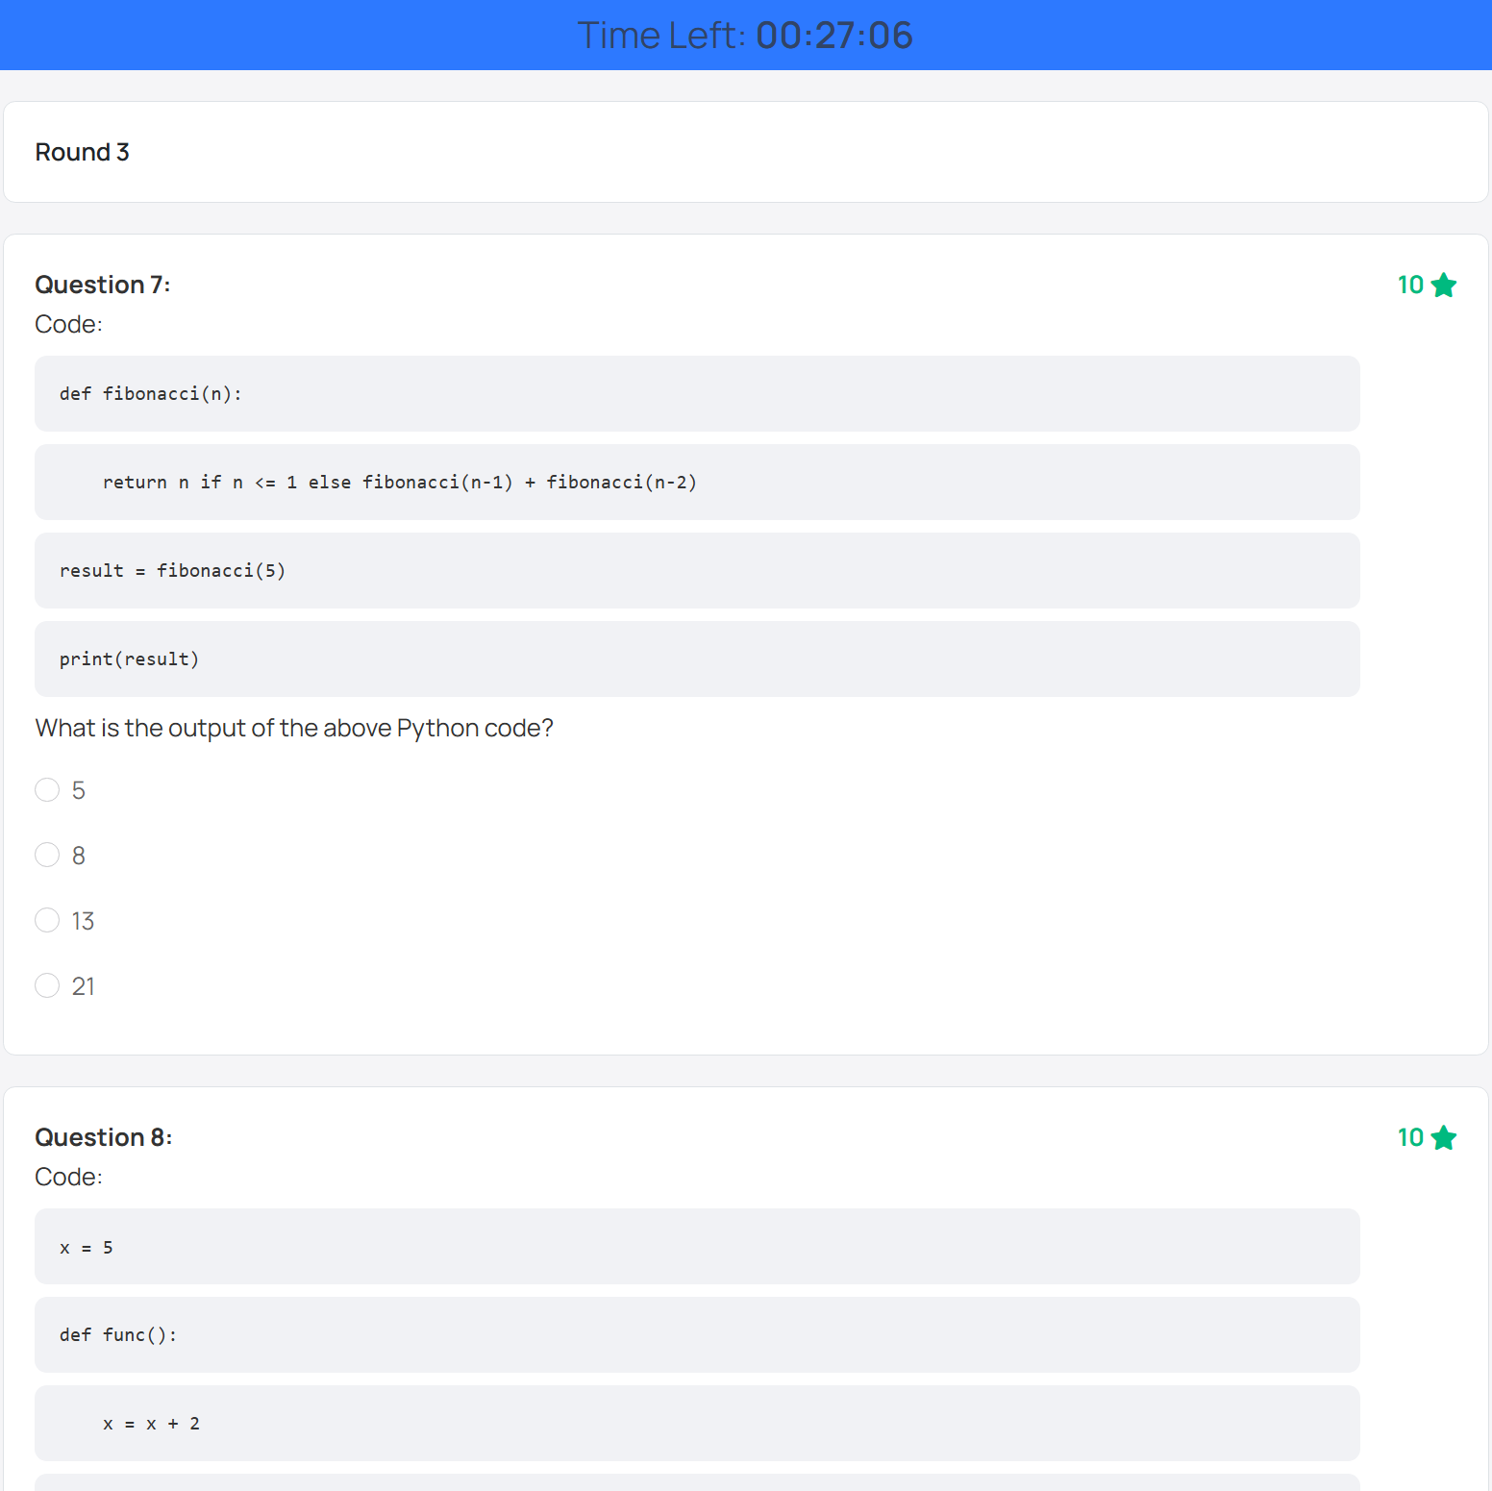
Interview Round
11 March 2024
Question rounds with a specified timer.
Team 14
Slide 29

Slide 30
Server Deployment
11 March 2024
09
Team 14
Slide 30

Slide 31
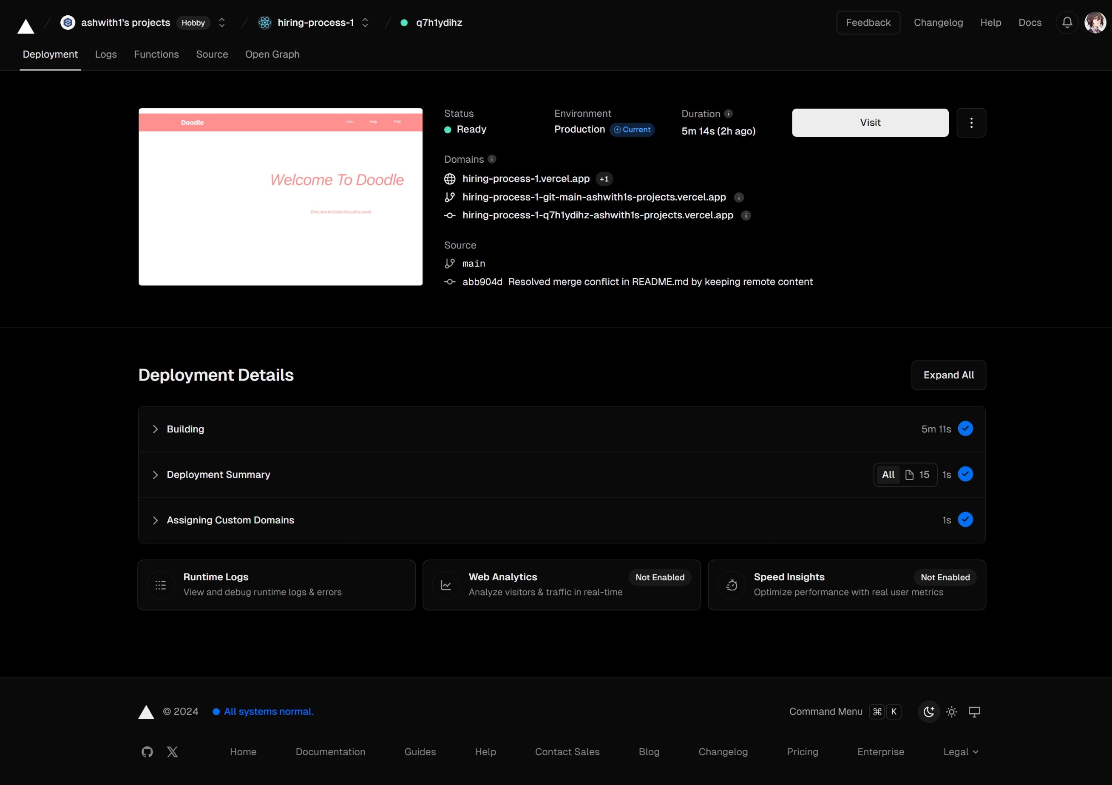
Server Deployment
11 March 2024
Vercel – Front End Cloud
Team 14
Slide 31

Slide 32
HR Interface
11 March 2024
10
Team 14
Slide 32

Slide 33
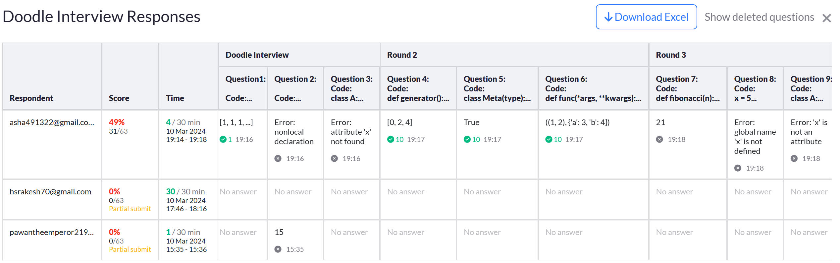
HR Interface
11 March 2024
Here the HR can look at Candidate responses and score.
Team 14
Slide 33

Slide 34
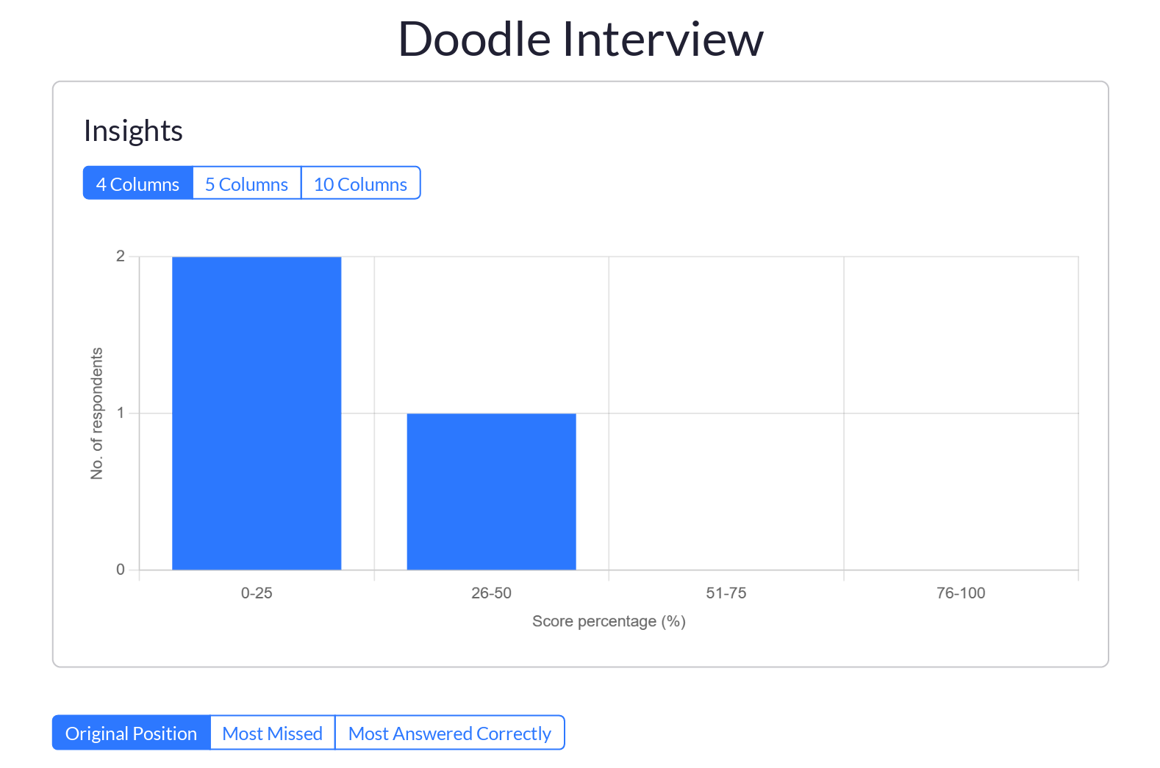
HR Interface
11 March 2024
Further insights
Team 14
Slide 34

Slide 35
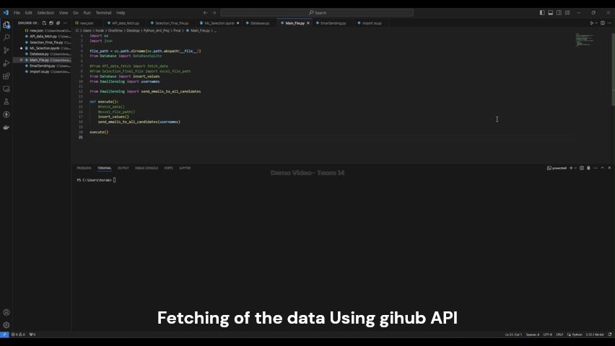
Demo Video
11 March 2024
Team 14
Slide 35

Slide 36
Challenges?
11 March 2024
What could not be implemented?
Web page interface where recruiter can initiate process
Unique Link that expire after a period of time
After Result, update about candidate acceptance or rejection(HR will do it manually)
System engineer process not considered
Team 14
Slide 37
Notes:
What could not be implemented?
Web page interface where recruiter can initiate process
Unique Link that expire after a period of time
After Result, update about candidate acceptance or rejection(HR will do it manually)
System engineer process not considered

Slide 37
What can be done Better?
11 March 2024
Unique Links
Multiple Sources to be considered
Fast Fetching of the user data
Team 14
Slide 37

Slide 38
References
11 March 2024
https://www.geeksforgeeks.org/
https://docs.github.com/
Team 14
Slide 38

Slide 39
THANK YOU!
11 March 2024
Happy doodling to you!
Team 14
Slide 39

